Slide 1
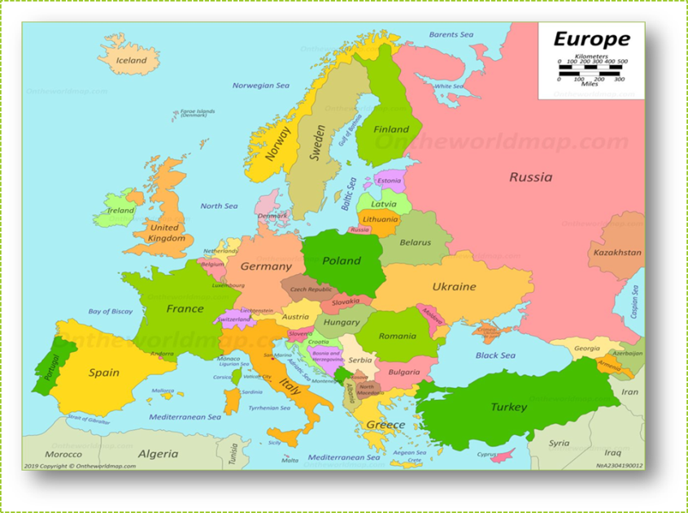
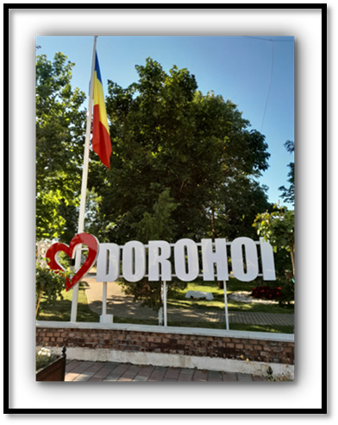
AGM Report
3RD FEBRUARY 2025

Slide 2
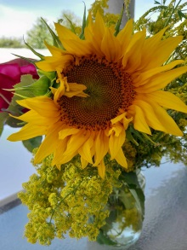
Introduction
As you all know, Light for Children helps children and young people who either live in the care system or have other special circumstances, in and around Dorohoi.
We also support a number of young adults who once lived in the care system but are now living independently in the community.
We continue to offer friendship and support to a special group of young adults with a chronic illness, who often need to spend lengthy periods of time in hospital.
We support a number of students who grew up with connections to Light for Children.
We work with the children and teenagers at a church in Dorohoi, teaching them to read music and play instruments, but above all helping them to feel that they are valued members of the church family.
I would like to take this opportunity to share with you some examples of how your generosity has enabled us to make a difference to individual lives during 2024.
**A much longer report was shared at the AGM itself but before going
on the website, I have removed all personal details.

Slide 3
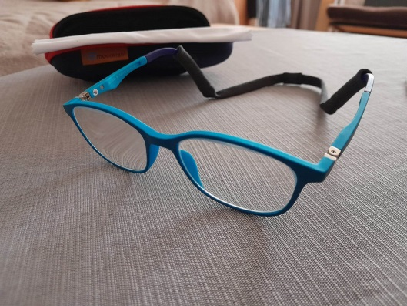
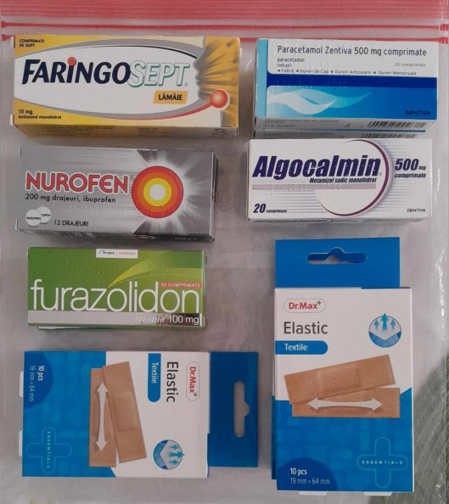
State run apartments in Dorohoi
There are currently 120 children and young people living in the state run apartments in Dorohoi. Their living conditions are very good and they have access to education at local schools, where they mix with children from families within the town. They are also registered with family doctors.
When the children first come into the apartments, they often have quite urgent medical needs, having been removed from situations in which they have either been neglected or experienced poverty. It is not unusual for them to arrive needing medication. Sometimes they haven’t got any personal belongings, so they need clothing, footwear and toiletries. The children may also need dental work and /or glasses. The difference that glasses can make to them is amazing and it is great to see how they react when they try their glasses on for the first time. Helping to meet these initial needs often builds a firm foundation for a good relationship with the children in the future.

Slide 4
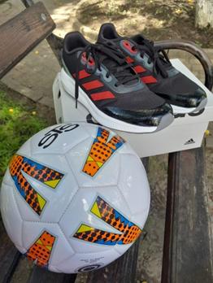
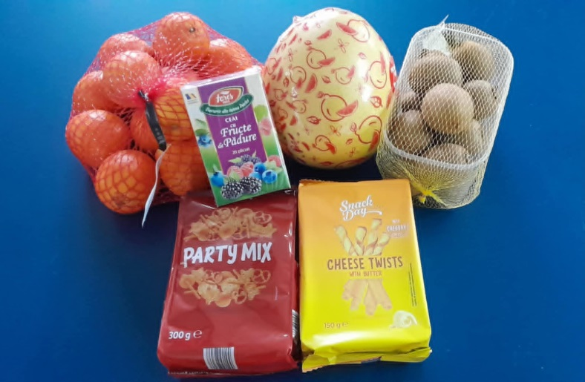
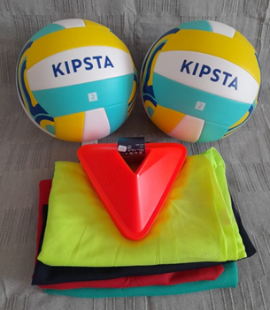
There are several times each year when we can do extra things for the children, to make their lives more enjoyable.
On 1st June, the children celebrate “International Children’s Day” and this enables us to give them sports equipment which they can then use throughout the summer.
During the summer holidays, small groups of children go to various camps, either in the mountains or at the seaside. We often provide their first aid kits and supply them with sun cream.
On the 6th December, the children celebrate St Nicholas’ Day, so this is an opportunity to visit each apartment with small gifts of fruit and other treats.

Slide 5
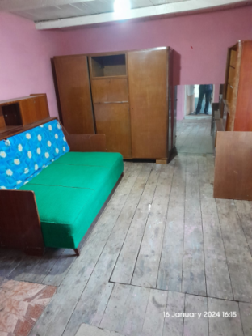
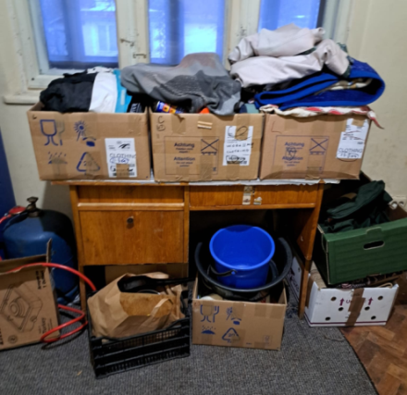
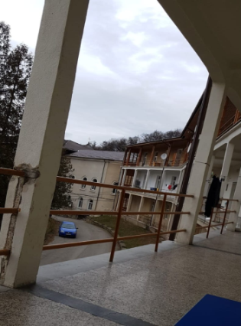
Support for those in hospital
A young man who was brought up in the orphanage in Dorohoi has been battling TB for the last twelve months in a sanatorium in Piatra Neamt, 100 miles from Dorohoi.
Prior to going into hospital, he rented a very modest room in Dorohoi but recently asked us to gather all his belongings together and store them for him until he returns. It is too far for us to visit him in hospital but we keep in touch and transfer some money to him each month, so that he can buy what he needs from a shop within the grounds of the hospital. When he is well enough to return to Dorohoi, we will help him to find alternative accommodation.
At the sanatorium, each patient has their own room with a balcony, so that they can benefit from the mountain air. For months, he was oxygen dependent but he assures us that he is gradually improving and can now go outside for walks.

Slide 6
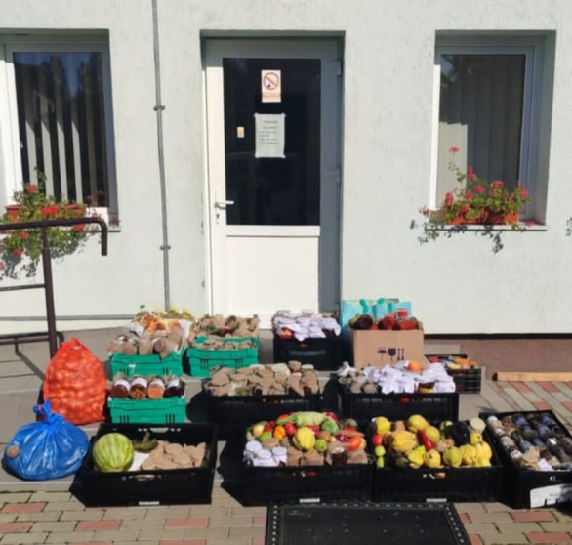
An inspirational young man
Another young man who grew up in the orphanage in Dorohoi, followed by the state run apartments in the town, went on to university in Suceava, where he graduated with a bachelor’s degree in food industry engineering and a master’s degree in social work. As a student, he lived in a halls of residence belonging to a sixth form school, situated directly behind the university. Having completed his studies, he was employed as a housemaster in the same halls of residence. This was ideal for him, as he was already familiar with the people and the environment. He was also able to have a room in the halls and to eat his main meals in the canteen, which enabled him to save a large part of his monthly salary. He now does an amazing job at looking after 12o teenagers!
Each autumn, he organises a special activity which involves a number of local high schools. The students donate vegetables and traditional home-made produce which is then distributed to people in need. They also put on a concert of traditional folk music and dance, keeping alive many local Romanian traditions.
He invites me to attend the concert each year and is clearly very well liked and respected. He has now managed to buy a small apartment in Suceava, consisting of one small room and a bathroom, which is a remarkable achievement for anyone of his age.

Slide 7
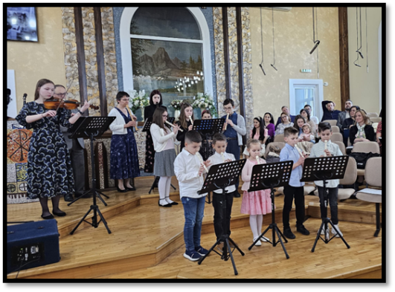
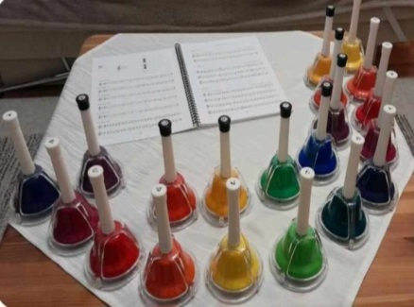
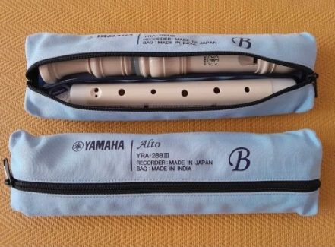
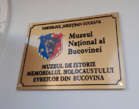
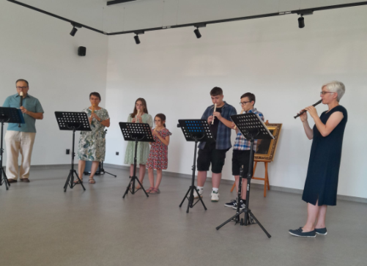
Church orchestra
The church orchestra has had a good year. We were very grateful to be able to buy new alto and tenor instruments, as well as a set of 20 tuned hand bells. As the children can read music, they are already able to play hymns in two voices on the bells.
New songs this year have included “I Vow To Thee My Country”, “Highland Cathedral” and “Joy to the World”!
During the summer we played in the courtyard of the original orphanage building in Dersca, which is now home to adults with learning disabilities. We also played a selection of Jewish music at a new history museum which has opened in Siret.

Slide 8
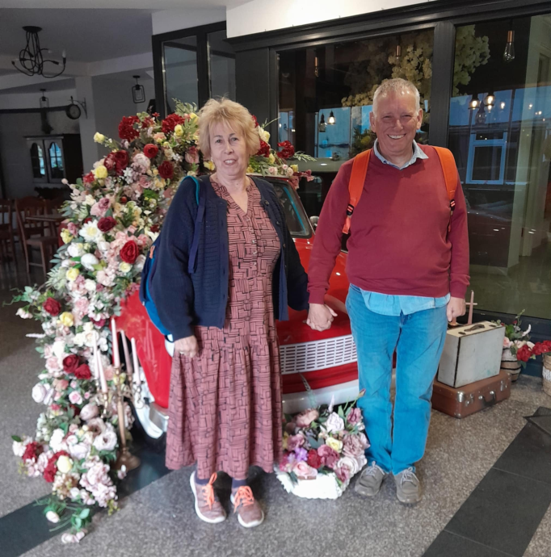
Wendy and Dave’s visit in May 2024
One of the things that Wendy, Dave and I did together during their visit in May 2024, was to go to the hospital in Botosani to visit two young adults, who were both receiving treatment there at the time.
Our visit took place on a bench by the hospital gate, so that we didn’t have to explain to anyone what was happening, but it meant so much to both of the young people.
Just the thought that Wendy and Dave had kept in touch for so long and had flown from England specifically to visit and encourage them, is still so special to them. This connection is priceless and something which gives them self confidence and dignity, not just for a particular moment in time but on the days when things are tough and nobody comes to visit.

Slide 9
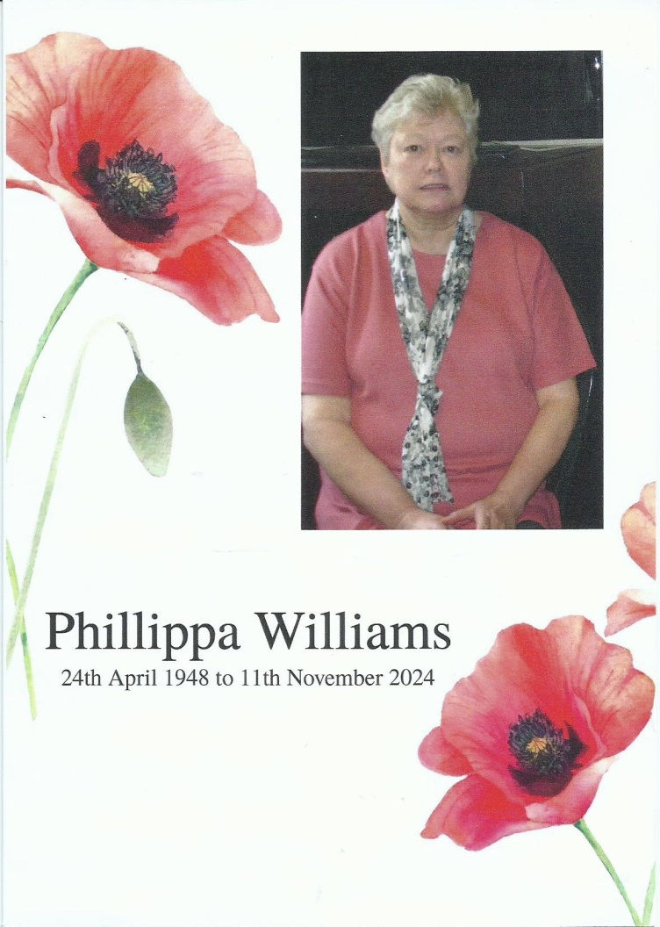
Pippa Williams
A special mention and thank you to Pippa, who sadly died in November 2024, but who supported the work of Light for Children from the very beginning.
I met Pippa when I worked briefly at the Benefits Agency in Cannock between 1996-1999 and she remained a kind, faithful friend, even after moving out of the local area to live in Wales.
Pippa was very interested in the Romanian children and also kept in touch regularly with Luminita.

Slide 10
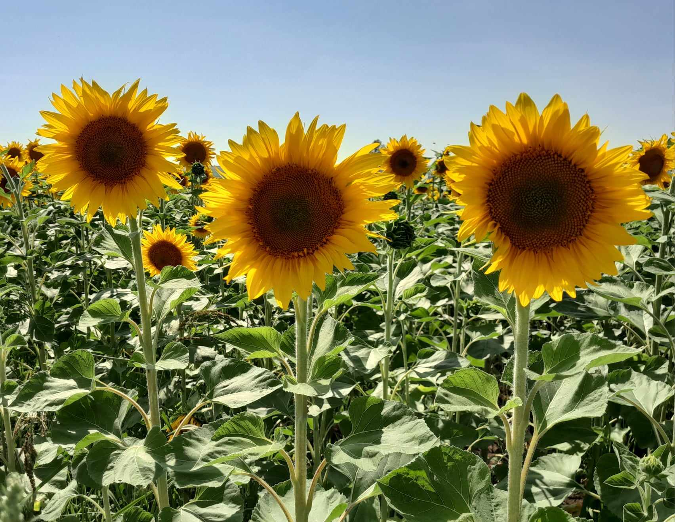
Thank you!
Our sincere thanks to you all for attending this meeting and for your generous support throughout the year.
Special thanks to the LFC committee who work so faithfully to raise funds and to keep everything running smoothly.
Thank you to everyone at St John’s for their ongoing support and for allowing us to use the church for fundraising events and tonight’s meeting.

