Slide 1
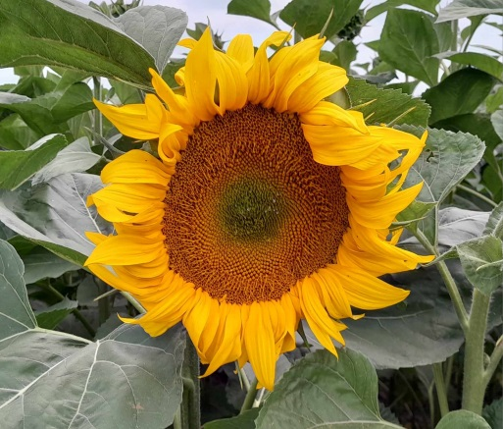
AGM Report
29th January 2024

Slide 2
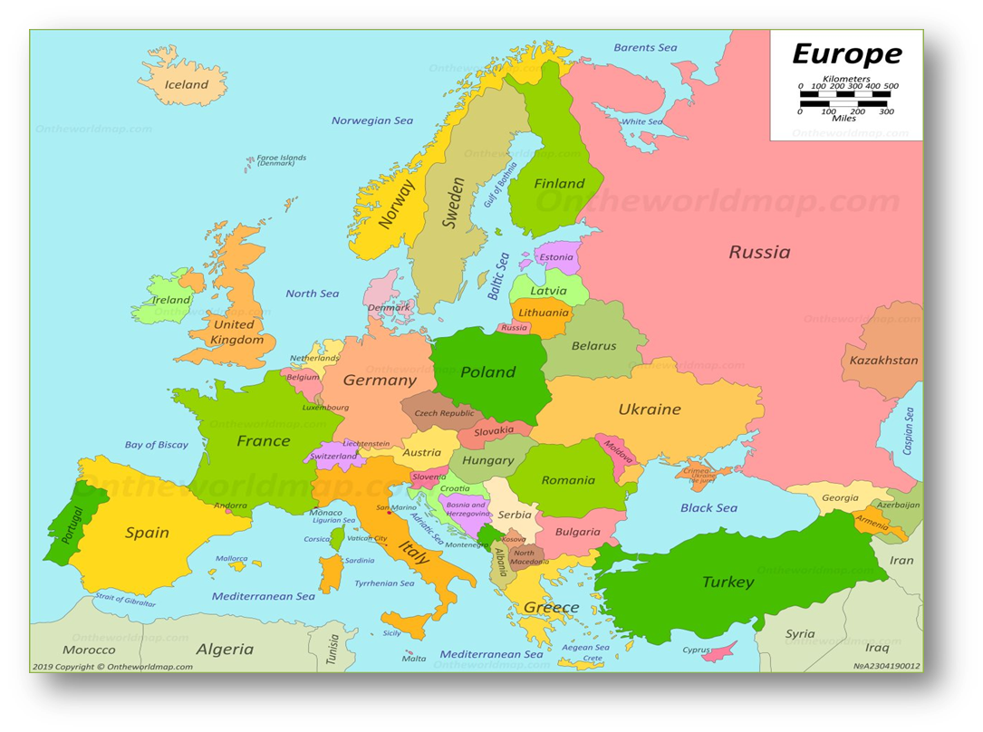
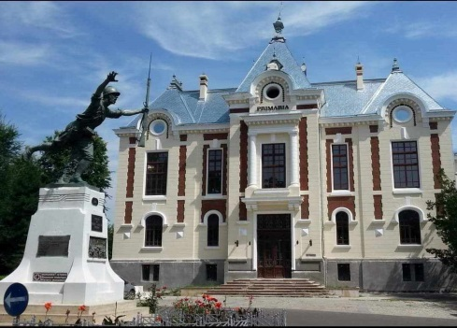
A review of the work carried out by LIGHT FOR CHILDREN
in and around DOROHOI in northeast Romania, during 2023.

Slide 3
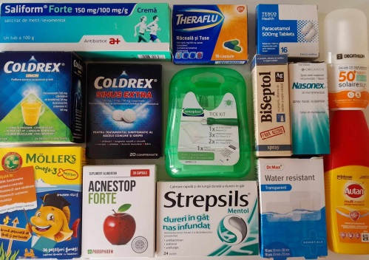
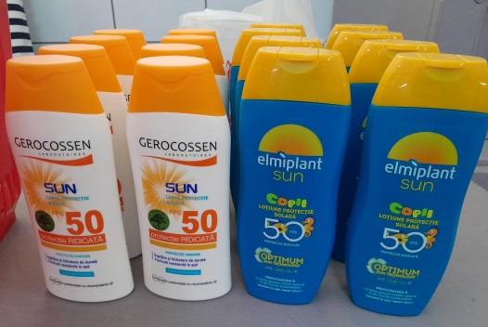
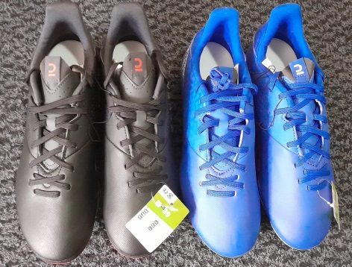
Children living in state run apartments
As in previous years, our priority has been to support the children and young people living in state care in Dorohoi. We have continued to pay for their prescribed medication, medical tests, first aid and sunscreen products, optician appointments, glasses and dental care.
We have encouraged the children to be as active as possible, providing suitable clothing, footwear and equipment for football, swimming and karate, as well as paying monthly subscriptions to a local sports club for those committed to attending weekly training sessions.
On several occasions we have proudly supported a group of children from the apartments who have competed in dance and performing arts festivals and competitions around the country.
We have funded school books as required.

Slide 4
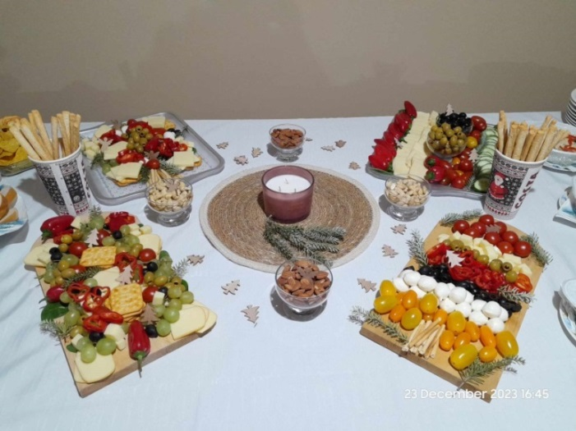
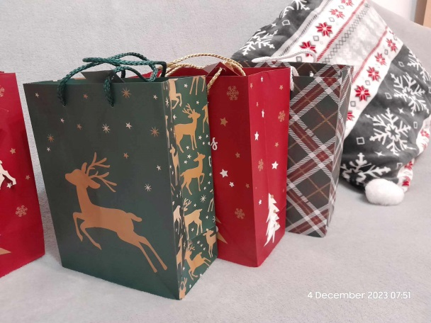
Christmas
For Christmas 2022 we prepared small gifts of fruit, juice and chocolate for all the children and young people living in the state-run apartments, which they received on 6th December, on St. Nicholas’ Day.
We also supported events being organised by other local charities for the same young people, often providing refreshments and/ or making arrangements for a suitable venue to be used.
For the young people from Dorohoi Baptist Church and other local village churches we organised a special evening celebration on 23rd December 2023.

Slide 5
University sponsorship
We have continued to provide monthly sponsorship for a number of university students, either from the care system or from local families. Each of the students has a remarkable story.
After sixth form, one young man went on to university, where he is now in the final year of his teaching degree. He is also very involved with the university orchestra and is a students’ advocate. During university holidays he gladly returns to play in our orchestra and often has a short sermon prepared to share with the church. These are his own words of thanks to you (sent to me in English)…….
“I would like to express my heartfelt gratitude to you for the invaluable support provided throughout my academic journey. Your dedication to assisting students like myself has been truly remarkable. Thank you for your unwavering commitment to empowering students and making a meaningful difference in our lives.”

Slide 6
Medical support
During 2023, we were able to offer financial support to many people for medical reasons.
During the year, we were contacted by a young man from Dorohoi who had been advised to have laser eye surgery abroad and was unable to cover the full cost himself. We were very pleased to be able to help him.
He is delighted with the results and is now able to see very well without glasses.
These are his own words (sent to me in English)…..
“I just wanted to say that I am deeply thankful to you and the headquarters of the association for your willingness to help me in this medical issue. It means the world to me. And you really help me to see "with new eyes“, to use a metaphor.”

Slide 7
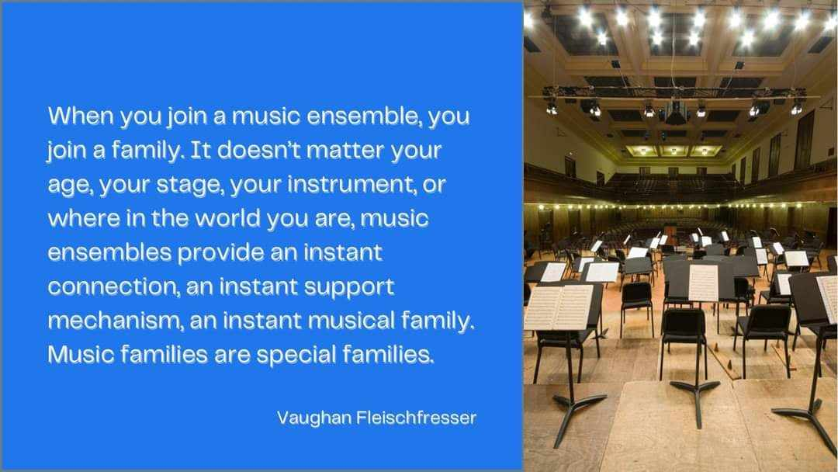
Orchestra
Our church orchestra is so much more than a music ensemble. It is about friendship, experiences, learning to be patient and enjoying seeing your neighbour thrive.
This year, we continued to add new songs to our repertoire, including “God Save the King” in May 2023 and “Behold our God”, a powerful worship song based on Isaiah 40 v 12-14.
During 2023, we welcomed 6 new members to the orchestra, five of whom are aged between 6 and 8 years old. They are learning to read music and have already been able to play several simple songs in the church, together with the older children.

Slide 8
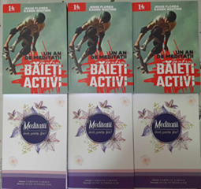
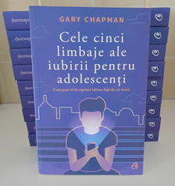
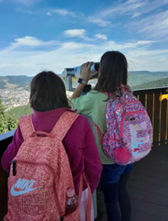
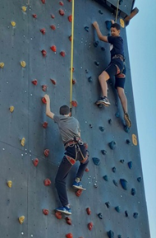
During the year, we gave the young teenagers their own devotionals and were also able to provide copies of “The Five Love Languages of Teenagers – The Secret to Loving Teenagers Effectively”, by Gary Chapman, to each family with teenagers in the church.
At the beginning of September, we took the orchestra on a daytrip to the mountains, where they took a chairlift to the top of a mountain to see magnificent views, hired quadracycles and learned to scale a climbing wall. For some of the children, this was their only opportunity to leave Dorohoi and spend time in the countryside during the three month school summer holiday.

Slide 9
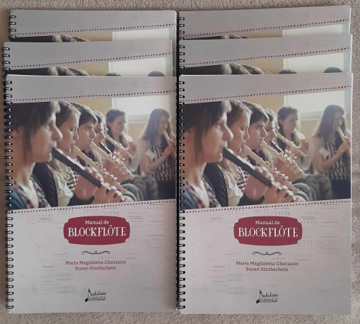
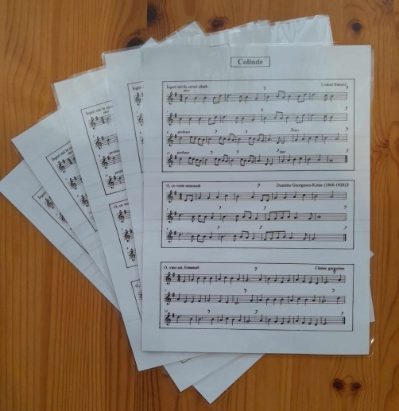
Afterschool music
I have continued to teach a group of children to play the recorder at a Christian school in Dorohoi, as part of their afterschool program.
The children are improving all the time and I do hope that during the coming year, they will have the opportunity to play alongside the church orchestra.
The children were very excited to be able to play Christmas carols this winter and one of the boys even came to play for us in our apartment on Christmas Eve!

Slide 10
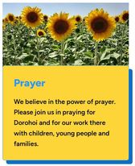
New LFC logo and website
During the summer months, Dave, Steve and I worked together (online) to prepare the content of the new LIGHT FOR CHILDREN website. We are very grateful to Steve Powell from Fellowship Studios, Rugeley, for designing the website and for keeping it up to date with news and announcements.

Slide 11
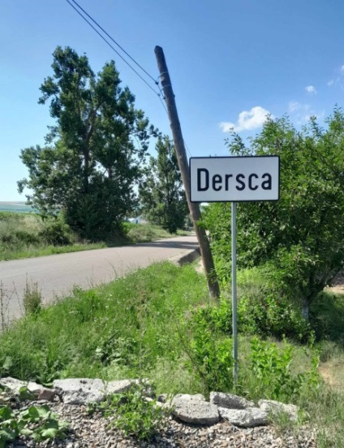
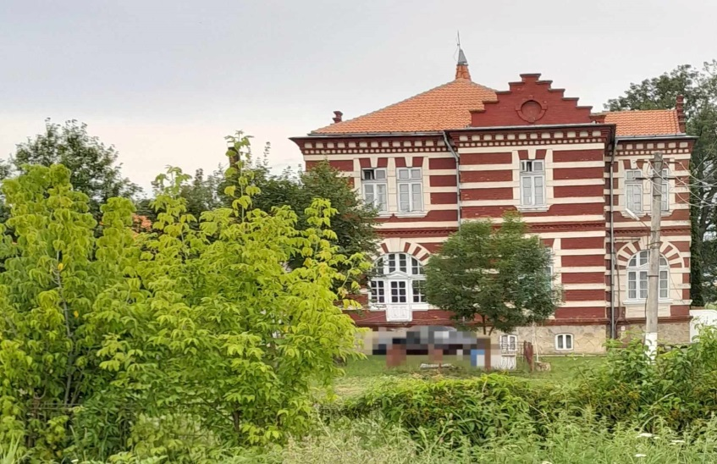
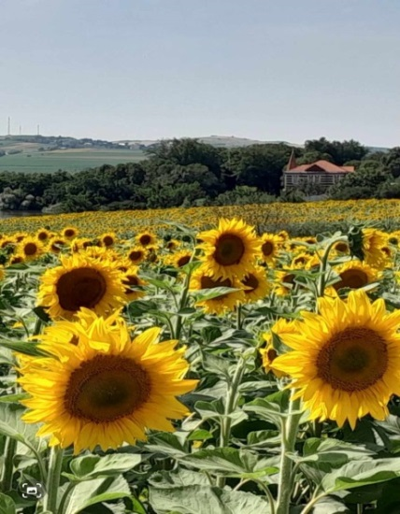
Dersca orphanage – the original children
As we were working on the website and thinking about how everything began, Costel and I went back to Dersca to take some photographs of the outside of what was the original orphanage building. The orphanage closed in 2001 and later reopened as a home for adults with special needs.
We are thankful to be in touch with many of the original children, who are now in their thirties.

Slide 12
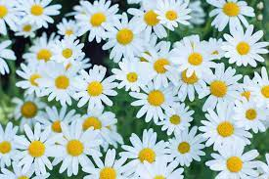
Thank you!
We would like to take this opportunity to say thank you for your amazing support over so many years, without which, none of what we have shared here would have been possible.
A special thank you to the LFC committee who have remained endlessly faithful to us from the beginning.
A special mention this evening to both Bob Baxter and Margaret Barnsley, both of whom have very sadly died during January 2024. We are so grateful for all the support that they have given to us over many years. We will continue to remember them with great affection.

