Slide 1
LIGHT FOR CHILDREN Report January 2022

Slide 2
A review of the work carried out by LIGHT FOR CHILDREN in and around Dorohoi, during 2021

Slide 3
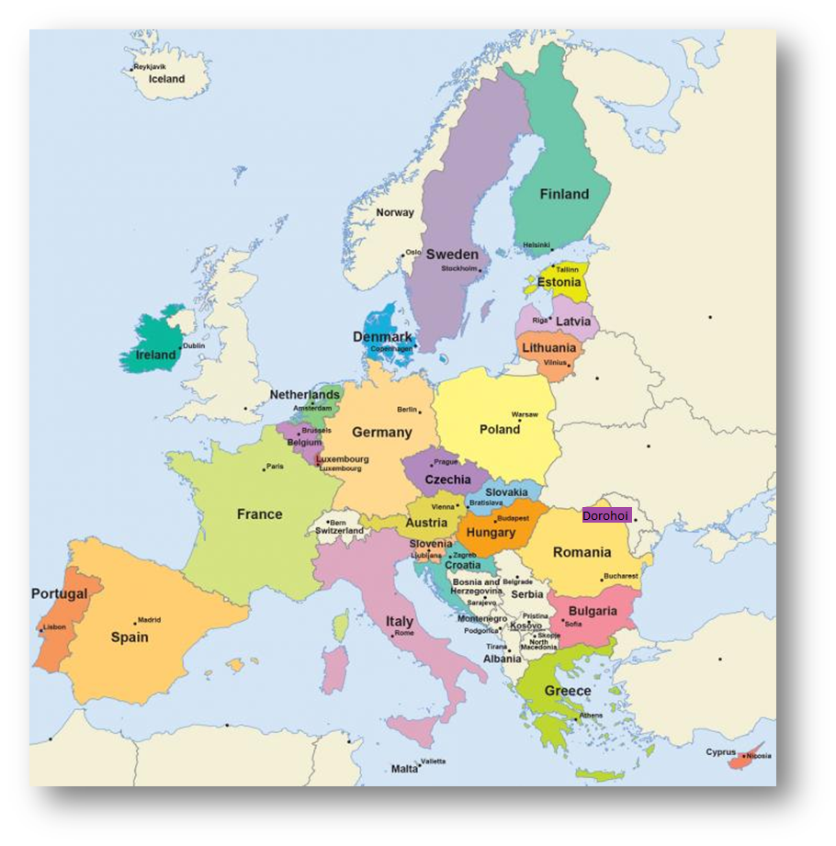
Dorohoi, in north east Romania

Slide 4
Introduction
Romania remains in a national state of alert, with the number of Covid-19 infections being at their peak. The average number of cases reported each day has reached a new high, with more than 19,700 people being infected daily. Just under 60,000 deaths have been reported in the country since the pandemic began.
Just over 50% of the population has been fully vaccinated. Masks and social distancing are still obligatory in all public places. Proof of vaccination is now required in order to enter shops, offices and restaurants, with the exception of food shops and pharmacies.
Most schools are currently open although the children have already had periods of online schooling this academic year. This is the third academic year that has been very disrupted for the children, which has caused a lot of anxiety and stress, particularly for the teenagers who have national exams in the summer.

Slide 5
Apartment children
We continue to support 140 children and teenagers in the state run apartments in Dorohoi. There are currently very few younger children under the age of ten. The majority are teenagers.
Generally speaking, the teenagers have been very understanding about the restrictions that are currently in place and have been kind and considerate to each other in these exceptional circumstances.
A special effort has been made to celebrate birthdays and other special occasions, which they all seem to love. Keeping spirits high and always having something to look forward to has been so important.

Slide 6
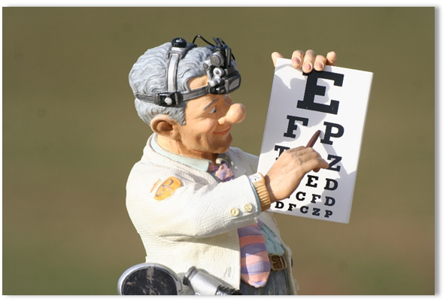
Medical support
Throughout the year, we have continued to support these children and young people by paying for any medication, dental work, optician appointments, glasses and other items that they have needed.
During the pandemic, a large number of the children and their carers have tested positive. Whilst some have had symptoms and required hospital treatment, others have been asymptomatic. We have been able to fund medication for those who have needed it. Thankfully, everyone has recovered.
Vaccinations are now freely available to anyone from the age of 5 upwards and many of the young people in state care have chosen to be vaccinated.
In the country as a whole, there appears to be a definite sense of fear and suspicion surrounding the vaccination program.

Slide 7
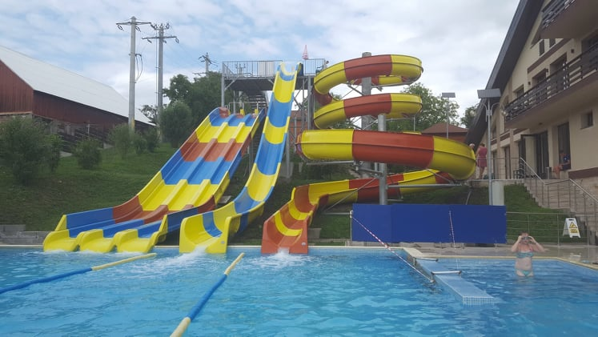
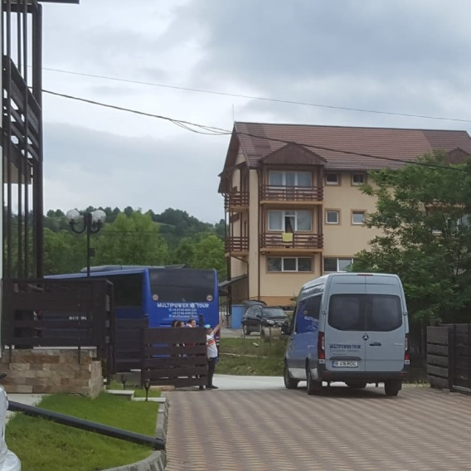
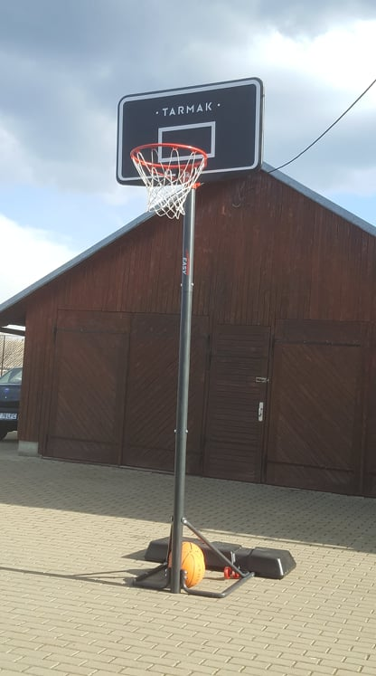
Sport and summer camp
With the children’s mental and physical wellness in mind, we have encouraged them to be as active as possible.
At Easter, we bought sports equipment for each apartment, including footballs, badminton and table tennis rackets. We also purchased a basketball net and balls for children to use at a local community centre.
During the summer holiday, we covered the cost of transport for a group of 60 children from Dorohoi to go to camp in the mountains, where they had access to a synthetic football pitch and a swimming pool. They also had the opportunity to visit a salt mine and to benefit from a series of talks designed to encourage them to make wise choices for their futures.

Slide 8
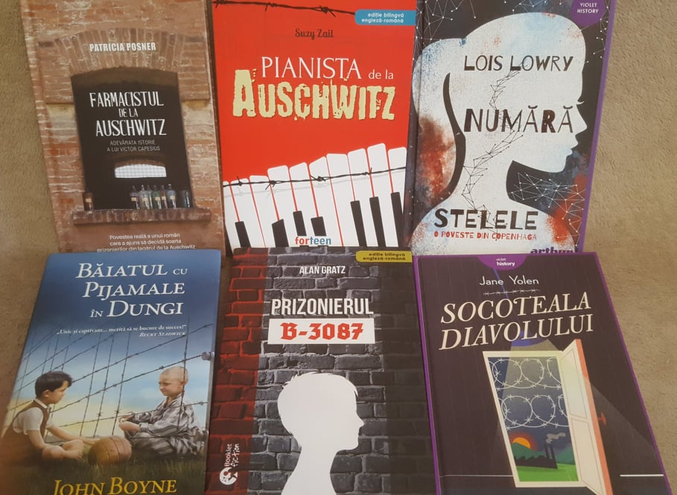
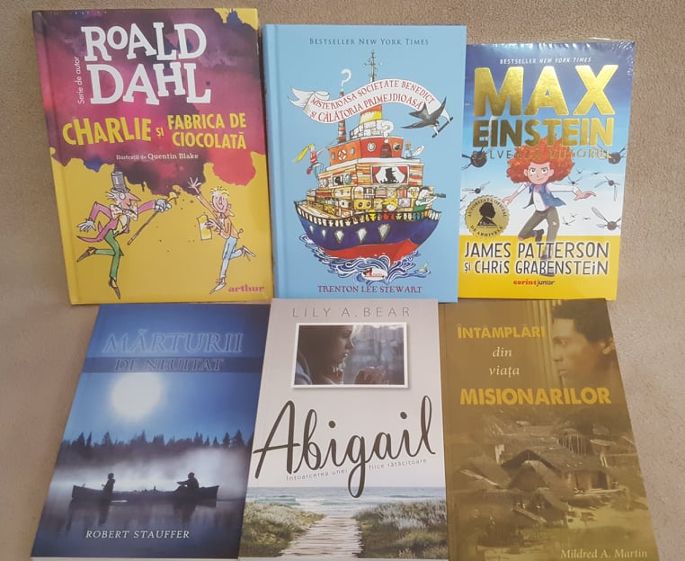
School books
We have continued to support a number of students, including young people from both state care and local families. One young man, whom we supported on a monthly basis for four years whilst at a Christian sixth form, is now in his first year at university, where he is studying to be a teacher.
We have also funded school books for children of all ages, from primary school through to higher education.
We have encouraged all the children we know to read as much as possible, either for school or for pleasure, sometimes offering a particular book and at other times, allowing the children to choose for themselves.

Slide 9
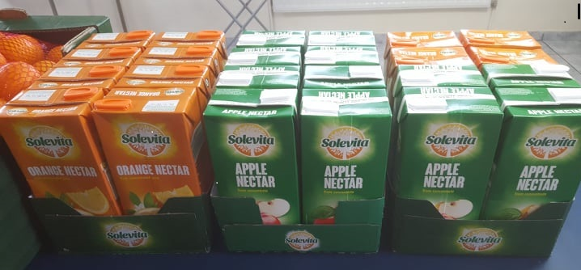
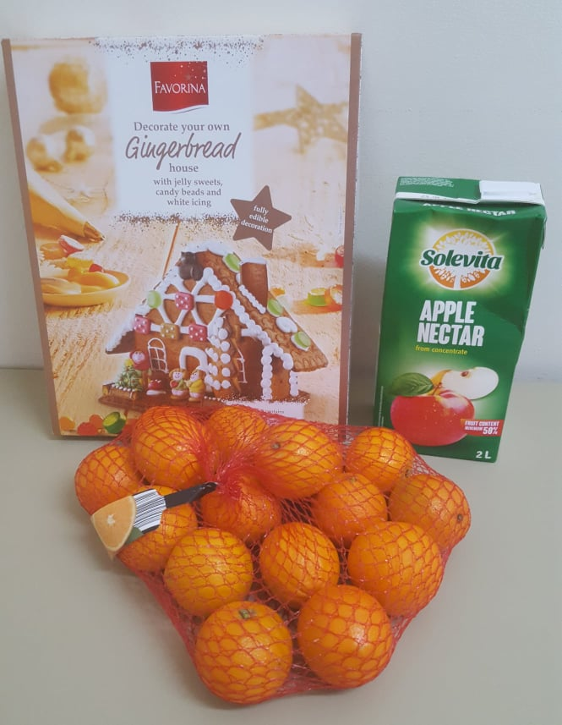
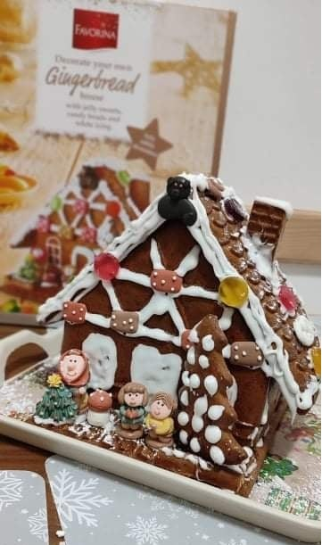
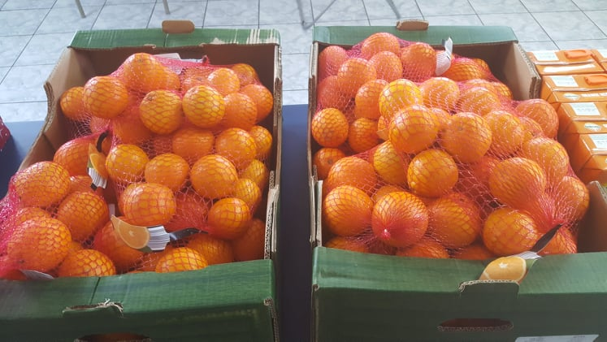
Christmas 2021
At Christmas, the apartment children received shoebox gifts from another charity, so we chose to make up gifts for each apartment, containing fruit, juice and a kit to make either a gingerbread house or train.

Slide 10
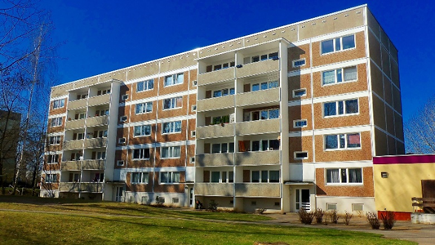
Young adults
We have continued to support a number of young adults who have left the care system and now live independently. Several of them continue to need help each year when applying for disability living benefits and when needing medical care.
In 2021, one of our young men moved into a brand new council property, a spacious one -roomed apartment in Dorohoi.
He is absolutely thrilled and has been able to furnish his new home beautifully. As a keen guitar player, a priority for him was to have his own microphone and music stand for rehearsals!
As a charity, our priority was to buy him an automatic washing machine!
He needed support to make contracts with the gas, electricity and water companies and is now feeling very settled in his new home.

Slide 11
Sense of community
We have been privileged to be able to keep in touch with a large number of the children whom we met 25 years ago, in either Dersca, Dorohoi or Botosani.
Over the years, we have shared every possible experience with them, including the excitement of celebrating their birthdays, the challenges of school life, the joy of baptisms, graduations, their weddings and the birth of their children, searching for homes for them to rent and then helping them to renovate and decorate properties .
We have also been there for those young people who have endured long term suffering as a result of life threatening illnesses and have felt the unimaginable sorrow of seeing a number of them lose their lives far too soon.
What has struck us time and time again is the overwhelming sense of community that exists between these young people, very few of whom are blood relatives. Whilst some have remained local to us in the county of Botosani, others have moved to work abroad in different European countries. With the help of the internet we have been able to keep in touch and I’m sure that we will always share a very special bond.
Earlier this month we lost a very dear young lady who has always been the cornerstone of this group of young people. She really did represent everything that we love and admire about the children and young people here.
Her funeral was unlike any other, with over one hundred people in attendance, including several of the doctors and nurses who had cared for her over the years. Three priests led the service and the priest who paid tribute to her life became emotional when he spoke of her kindness , her courage and the lives that she had touched.
We feel beyond privileged to be part of their community.

Slide 12
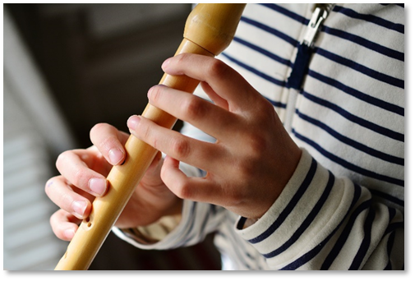
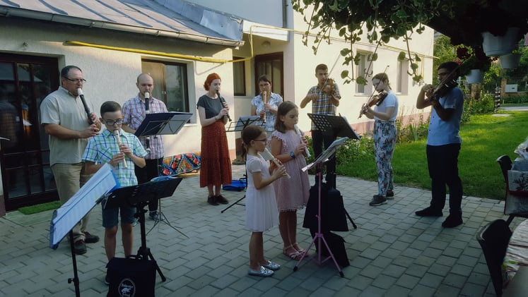
Church orchestra
The church orchestra started as a small group of descant recorder players, 10 years ago. It has since grown to include descant, alto and tenor recorders, as well as violins and a clarinet.
During the pandemic there have been periods when we haven’t been able to rehearse but since Easter 2021, we have tried to meet again regularly.
In September, we spent an evening visiting elderly members of our congregation and playing hymns for them in their own gardens.

Slide 13
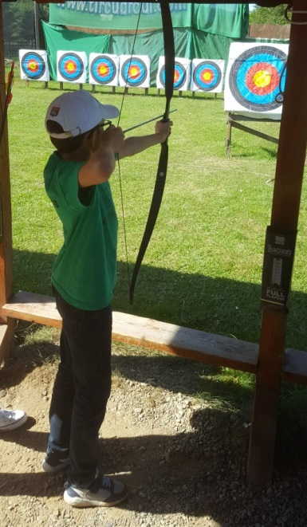
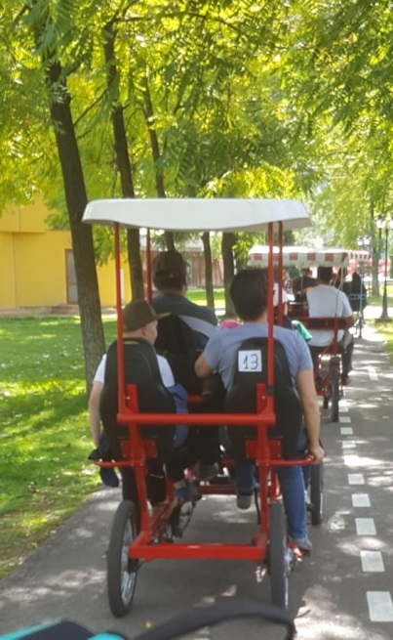
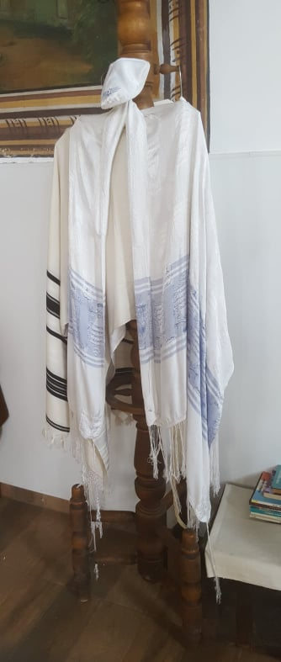
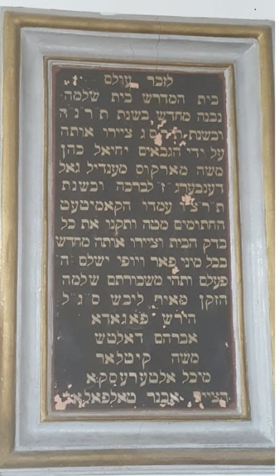
In September, we took the orchestra on a daytrip to the mountains, where the children and young people were able to try a variety of outdoor activities and explore the beautiful Romanian countryside.
We also had the opportunity to visit the synagogue in Dorohoi, where we played a short repertoire of Jewish songs and learned about local Jewish history.

Slide 14
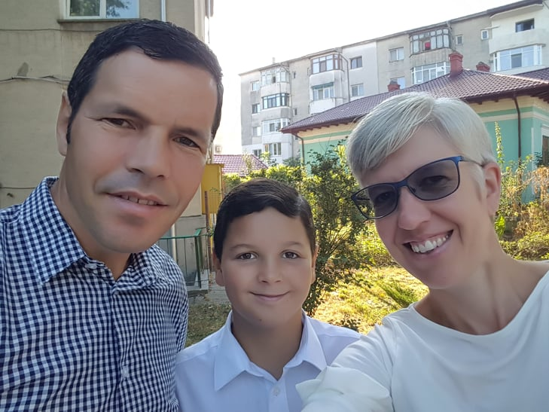
Thank you!
We can’t thank you enough for all your support, without which none of what we have shared with you today would have been possible.

