Slide 1
Light for Children AGM Report
30th January 2023

Slide 2
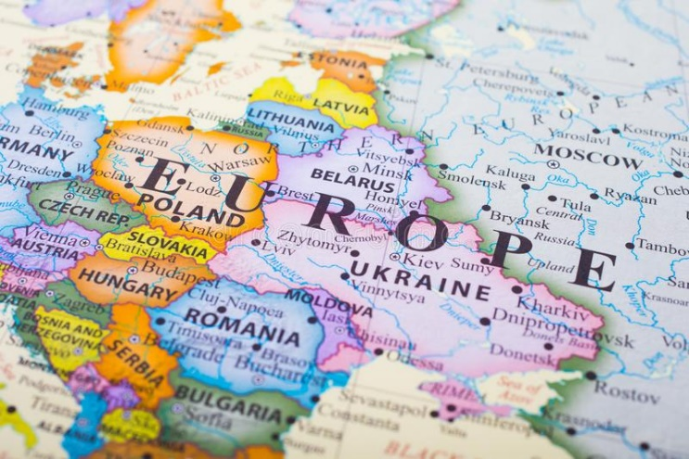
A review of the work carried out by
LIGHT FOR CHILDREN in and around Dorohoi, Romania, during 2022.
It was by the Spring of 2022 that Romania saw the end of restrictions related to Covid 19. After such a challenging time, we had no idea that the war in the Ukraine would have such an impact on our part of Romania almost immediately.
In this report, I will attempt to talk you through the situation that we were faced with at the beginning of the year and the people and projects we were able to support, in and around Dorohoi, during 2022.

Slide 3
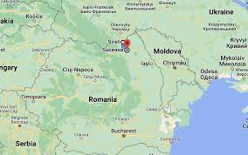
War in Ukraine
In Dorohoi we are just 30km from the nearest border crossing into the Ukraine and even closer to the physical border, which is on the outskirts of Dersca.
Just days after the Russian invasion of the Ukraine on 24th February 2022, the people of Romania responded to the crisis in a phenomenal way. Government authorities, national and local charities, churches and individuals made their way to the border to offer emergency supplies, transport and accommodation to the refugees. Whilst some families were able to leave the Ukraine together in their private cars, many mothers and their children walked for days to reach the border, carrying only whatever they could fit into a rucksack, with no particular destination in mind, just a desire to flee to safety.
Of the 8 million refugees who fled the Ukraine in 2022, approximately 1.5 million entered Romania, of which around 87,000 are thought to be still living here. Many have travelled further west to other countries.

Slide 4
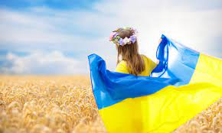
Helping Ukrainian refugees in Dorohoi
The Coronavirus vaccination centres in Dorohoi were closed as soon as the war in the Ukraine began and the local authorities turned their attention to the influx of refugees that immediately followed.
Whilst I was more than willing to support the refugees, I was also aware of the need to continue to offer support and stability to the children and young people living in state care here throughout this unsettling time.
For 4 months (from the beginning of March until the end of June), I volunteered each morning at a local charity on the outskirts of Dorohoi, which was able to accommodate up to 70 refugees at any one time. There I was able to help by taking care of a storeroom of food and hygiene products which the refugees could access each day, without being required to pay for anything.
There are still three Ukrainian families living independently within the grounds of that charity and a number of other charities in the town continue to provide long term accommodation for a small number of refugee families. We have become friends and I still support one family in particular when they need a translator or information from local offices.

Slide 5
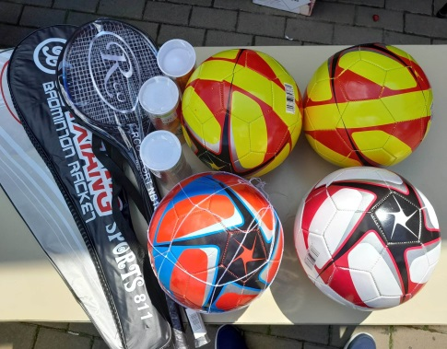
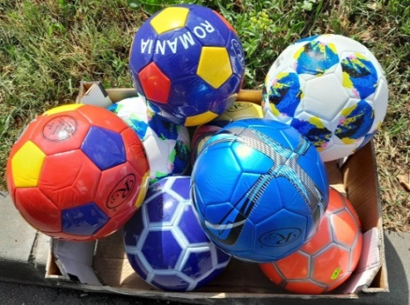
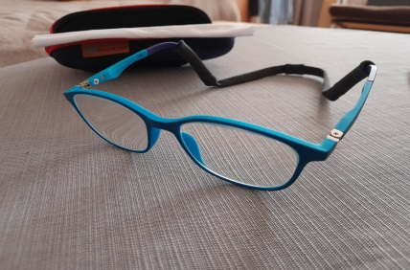
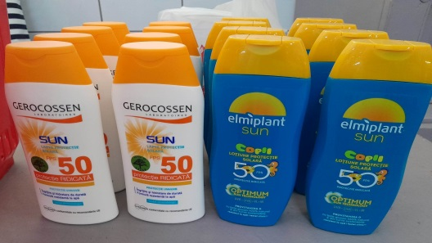
Children living in state run apartments
Throughout 2022, we continued to support the children and young people living in state care in Dorohoi by paying for their medication, dental work, optician appointments, glasses and other essential items.
We have continued to encourage the children and teenagers to be as active as possible.
At the beginning of June we provided them with footballs and badminton rackets and have supported them with equipment and supplies for various camps and trips over the summer months.

Slide 6
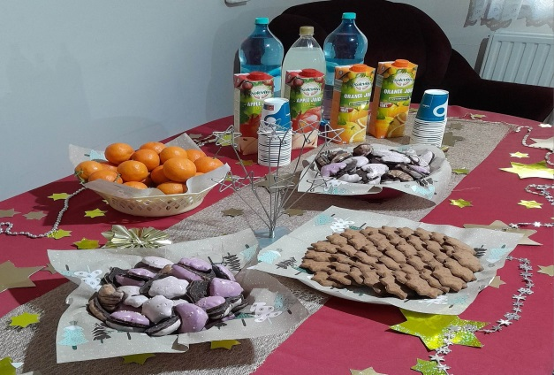
Teenage girls
Having worked closely with a German missionary in Dorohoi at various times over many years and again with the refugees, we both felt that we should be spending more time with teenage girls in the town who are particularly vulnerable.
We have been meeting with a group of approximately 12 girls on a monthly basis, really as a youth group would meet. Sometimes we have serious discussions about the life-choices that they need to make. At other times we play games together, sing songs or share food. Some of the girls have arrived fairly recently in Dorohoi, having faced difficult situations at home. They talk to us about their individual situations, their hopes and plans for the future. We welcomed the New Year in with these girls both in 2022 and 2023.

Slide 7
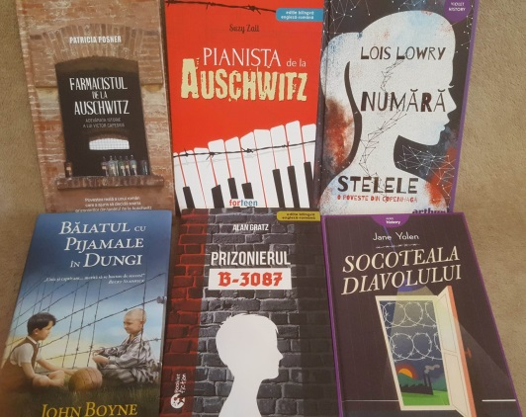
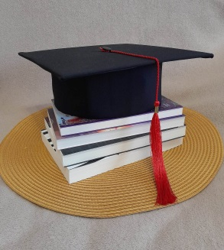
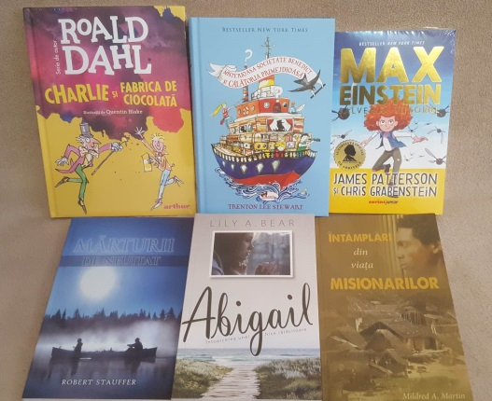
Education
We have continued to support a number of university students, who grew up within the care system, as well as to fund school books for the children currently living in the state run apartments.
Two exceptional foster brothers have chosen to study teaching and nursing at different Romanian universities, which we are sure will empower them to go on and make a huge difference in the communities in which they choose to live in the future. Both young men came home for Christmas and played their violins with the church orchestra.

Slide 8
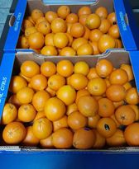
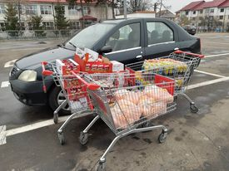
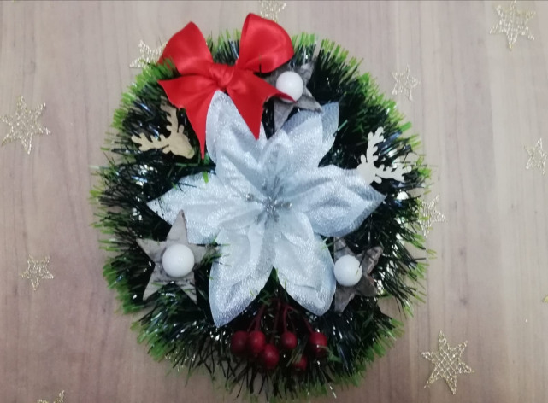
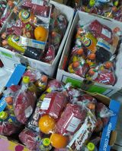
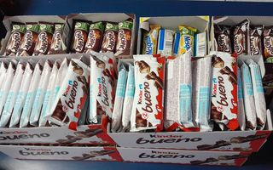
Christmas
Thanks to your generous donations we were able to prepare individual Christmas parcels for the children and young people living in the care system in Dorohoi (120). These were given to the children on 6th December, which is when St Nicholas’ Day is celebrated. During the Christmas holidays, the children also received shoebox gifts from an American charity based in Suceava.

Slide 9
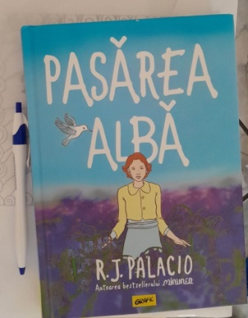
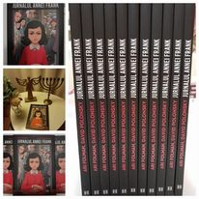
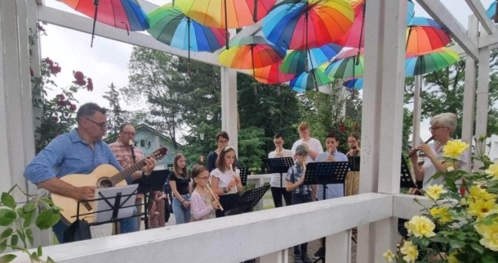
Church orchestra
The church orchestra has continued to rehearse regularly and to play at different local venues. In the Spring, we learned to play the Ukrainian national anthem, which has touched the hearts of a number of refugees who have visited our church. In June, we were invited to play a repertoire of Jewish music in a park in Dorohoi, as part of a festival to celebrate International Children’s Day. In September, it was time to prepare the 70th piece of music in our repertoire and so it seemed right that we should honour HM Queen Elizabeth II by choosing “Love divine, all loves excelling”.
As in previous years, I have encouraged the children to read inspirational books, such as “Anne Frank, the diary of a young girl” and “White bird” by R.J.Palacio. During the summer holidays, we had the opportunity to meet and discuss the books.
In the autumn, we took a Friday evening off from rehearsing to attend a concert in Botosani, where we listened to a philharmonic orchestra playing with guest soloists on violin, cello and piano.

Slide 10
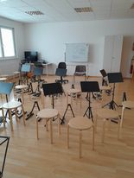
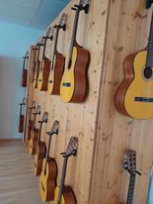
Afterschool music
Since the start of the 2021/2022 academic year, I have been teaching children at a school in Dorohoi to play the recorder as part of their afterschool program. Since the start of the current academic year, two Ukrainian children have also joined the group. The children are now able to read music and play simple songs. They are very enthusiastic!

Slide 11
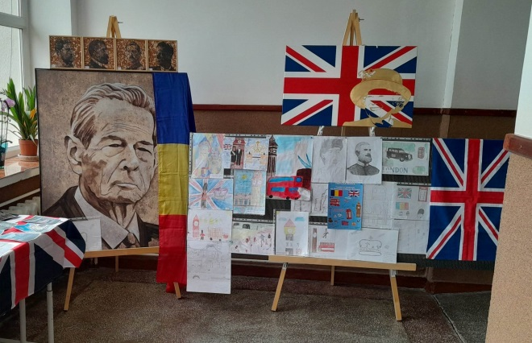
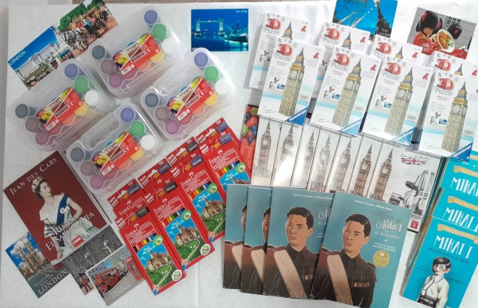
Her Majesty the Queen
As we celebrated HM the Queen’s Platinum Jubilee in June 2022, I was keen for local children here to learn more about her and her connection to the Romanian royal family. With the help of a friend who is an art teacher, we arranged for there to be an art competition at a local school, entitled:
“Royal families, traditions and symbols in Romania and Great Britain.”
All the children who took part received McVitie’s chocolate digestives as well as other specially chosen prizes (3D puzzles of Big Ben, books, paints and other art equipment).

Slide 12
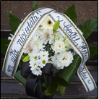
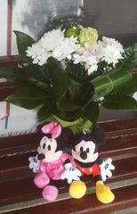
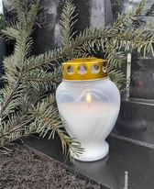
In loving memory...
During 2022, we sadly lost two of our young ladies to chronic illnesses, leaving behind grieving husbands and children.
We had known both girls since they were young children, so it was a privilege to be able to take part in their funeral services, during which we were reminded once again about the strength and beauty of their characters, as well as the impact that their lives had on so many people across the world.

Slide 13
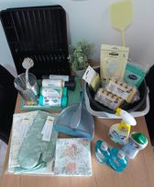
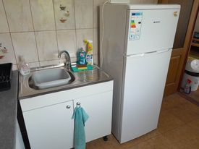
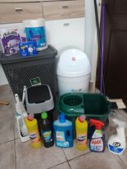
A home improved…
Approximately 18 months ago, one of our young ladies was allocated a small council flat on the outskirts of Botosani. Due to restrictions, I didn’t see the property straight away but asked if there was a central heating boiler, a fridge, cooker, bed, table etc. The answer was always “yes”, so I presumed that the basics were all there.
In January 2022, the young lady had to isolate at home for 14 days. I went over to see her several times, taking food and medication. I was saddened to see that although she had got a central heating boiler, she wasn’t sure how to use it, so it was cold in her apartment. She did have a cooker and a fridge in the kitchen but nothing else, not even a kitchen sink. Her bathroom was furnished but in need of a deep clean.
We have since improved things considerably, working closely with another Christian organisation in Botosani.

Slide 14
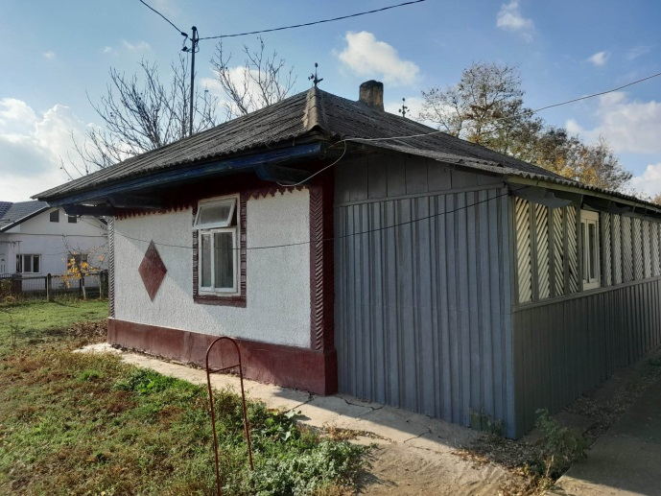
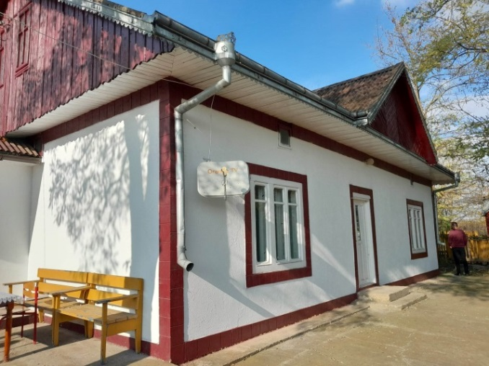
A village property repaired and painted…
Last summer we were fortunate enough to have both the opportunity and resources to invest in the upkeep of a village property which is currently home to two young men who require supported living. The two buildings were repaired and painted on the inside and outside to ensure that they are clean and well maintained. One of the young ladies who sadly died last year actually lived here for a time before she married, so we felt that this was something we could do in her memory, to help other young people in a similar situation. When the renovations were complete, we also planted flowers in the garden to remember the young ladies who have passed away.

Slide 15
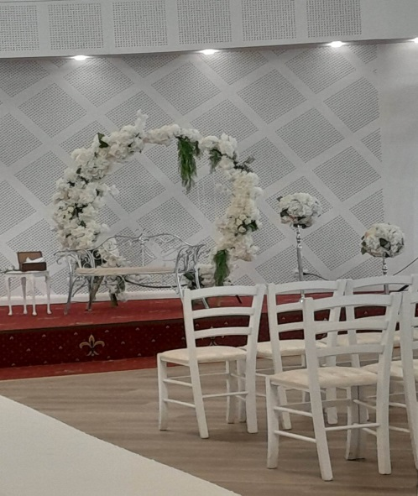
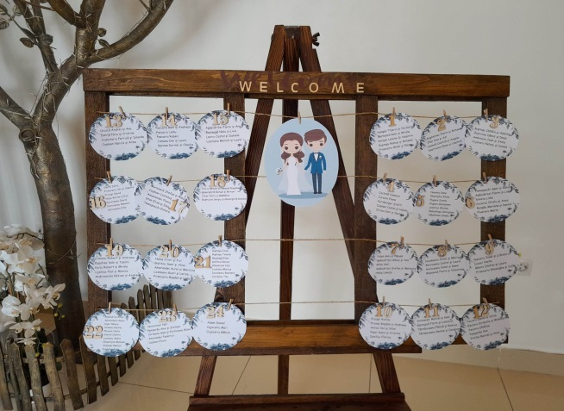
A wedding
We were delighted to be able to attend a special wedding in August 2022.
Both the bride and the groom came to LFC camps with us on different occasions, the groom in 2003 and 2006, the bride in 2012.
Before their wedding they came to visit us to say that some of their best childhood memories had been made during the various camps and holiday clubs that had been organised by LFC with teams of friends from England.

Slide 16
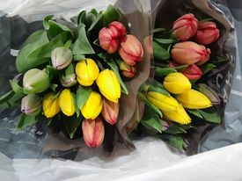
Thank you!
Our sincere thanks to everyone who supports Light for Children.
This evening we have been able to give you just a taste of what we have been able to do here over the last twelve months because of the support that you have provided.
Thank you for your prayers, for supporting fund-raising events, for your regular giving or one off donations. Thank you for taking the time to attend the AGM this evening and for your encouraging messages of friendship and support throughout the year.
A special thank you to the committee for their faithful hard work.
Helen and Costel

